Slide 1
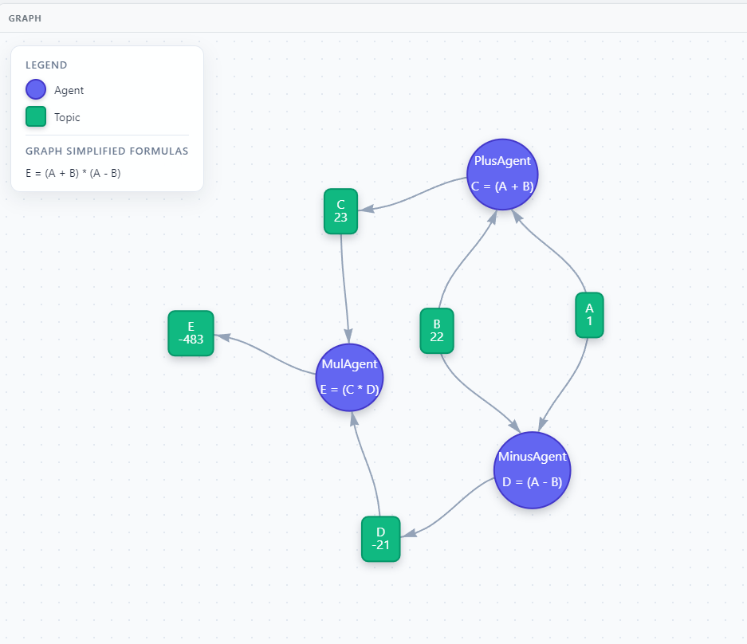
Advanced Programming 83677: Computational Graph Project
Name: Bar Ben Haim
ID: 212214498
Email: Bon23174@gmail.com

Slide 2

The Problem & Background
Building computational graphs quickly and efficiently is challenging.
The Ap-graph project offers a configurable solution that enables real-time processing and a generic REST + pub/sub infrastructure.
The project supplies a generic server interfaces, and their implementation, for:
managing the graph.
uploading config files.
sending messages to topics to trigger calculations.
restarting/deleting configuration.
managed in Railway cloud with tests and automatic CI/CD when merging to main branch.

Slide 3
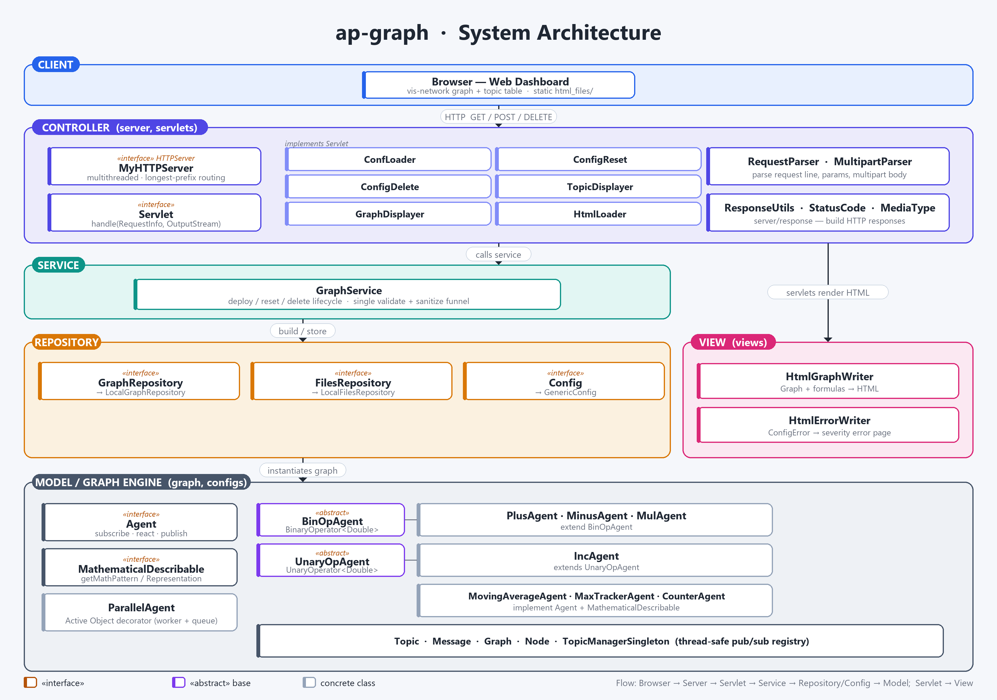

Slide 4
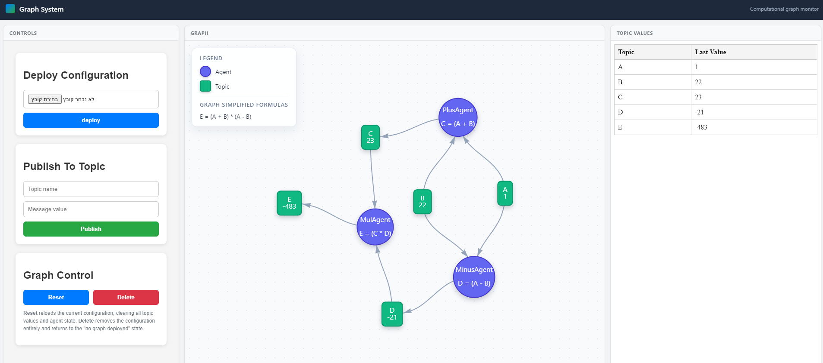
Live Demo Overview

Slide 5
Key Takeaways from My Experience
Design & Extensibility
Concurrency and scale
Infrastructure & Security
Designing generic, extensible classes by SOLID and interface-driven code
Active objects and thread-safe pub/sub architecture and design patterns, with open/closed principle and scalability options in the future
Custom HTTP server, REST and parsing
Docker, CI/CD and testing
Security with files and injections
Databases integration (Stateless)
RESTful API
Documentation
Made the repository interfaces generic for future database integration — not required by EX.6 (e.g. Redis for files, Postgres/Mongo for graph & topic state)
Learned what it takes to design a clean, generic RESTful API
Learned how to create a well documented code with javadocs for future developers.

